Slide 1
VLSI DESIGN
Lecture 2
B.E (ECE) 5th semester

Slide 2
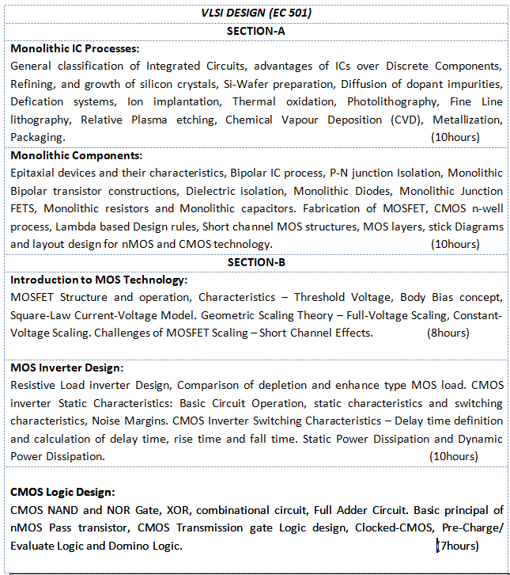

Slide 3
General Classification of ICs
Based on Fabrication
Monolithic ICs
Hybrid ICs
Based on Application
Analog ICs
Digital ICs

Slide 4
Difference between discrete circuits and integrated circuits
An integrated circuit is a circuit made of transistors and other components etched onto a single semiconductor substrate. ...
A discrete circuit is a circuit made of transistors and possible some ICs that are on different semiconductor substrates and wired together with mechanically connected wires and printed traces.

Slide 5
Advantages of IC over Discrete Circuits
Speed: Increased operating speed because of absence of parasitic capacitance effect.
Size: Thousands times smaller than discrete circuits. It is because of fabrication of various circuit elements in a single chip of semiconductor material.
Cost: Very low cost because of simultaneous production of hundreds of similar circuits on a small semiconductor wafer. Owing to mass production of an IC costs as much as an individual transistor.
Power reduction: Lower power consumption because of their smaller size.

Slide 6
Basic Principle
Realization of electronic circuits can be done by”
Discrete components on board (PCB)
Integrated Circuits (IC)
IC is a tiny electronic circuit in which various components are fabricated on crystalline semiconductor material. Without IC’s devices like laptop, mobile etc. could not be possible.

Slide 7
Semiconductor is a material with conductivity in between that of metals/insulators.
These are important because their properties can be changed by doping with impurity. They are found in column 4 of periodic table (known as elemental SC).
In addition to elemental SC, atoms from column 3 and 5, column 2 and 6 combine to form compound SC.
III-V | II-VI | IV
GaAs | ZnS | SiC
AsP | ZnSe
GaN | ZnTe
GaP | CdS
InP | CdSe
InAs | CdTe
InN

Slide 8
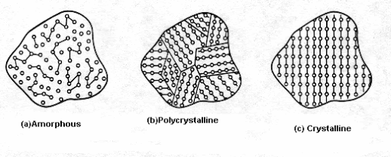
There are two main categories of solids: Crystalline and Amorphous.
Crystalline solids are well ordered at the atomic level, and amorphous solids are disordered.
A crystalline material with a single grain is called a single crystal. ... A crystalline material consisting of many grains of different orientation (like a ceramic) is called polycrystalline.

Slide 9
Crystalline Solids
These are the most common type of solids.
They are firm, hold a definite and fixed shape, are rigid and incompressible.
To understand crystals we must understand their structure. The arrangement of particles in a crystalline solid is in a very orderly fashion.
The spaces between the atoms are very less due to high intermolecular forces. This results in crystals having high melting and boiling points. The intermolecular force is also uniform throughout the structure.

Slide 10
Amorphous Solids
Amorphous solids are rigid structures but they lack a well-defined shape. They do not have a geometric shape. So they are non-crystalline. This is why they do not have edges like crystals do.
The most common example of an amorphous solid is Glass. Gels, various polymers, wax, thin films are also good examples of amorphous solids.
This variation in characteristics of solids occurs due to the arrangement of their molecules. Here the particles of matter do not form the three-dimensional lattice structure that we see in solids.
Some naturally occurring amorphous solids have impurities that prevent such a structure from forming. So they have a short order arrangement of molecules.

Slide 11
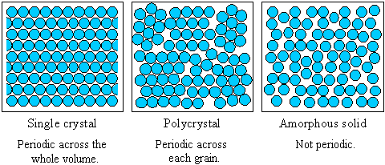
The range of crystalline order distinguishes single crystals, polycrystals and amorphous solids. The figure shows how the periodicity of the atomic structure of each type of material compares.

Slide 12
Various steps involved in IC fabrication are:
Crystal formation
Wafer Preparation
Thermal Oxidation
Photolithography
Etching
Diffusion
Ion Implantation
Chemical Vapour Deposition
Physical Vapour Deposition
Metallization
Packaging

